Slide 1
DSAC Developers Simplicity By Automating Code
BY :-
48. Parth Patel
59. Nupur Rathod
64. Bharat Sharma
69. Swaralli Tannu

Slide 2
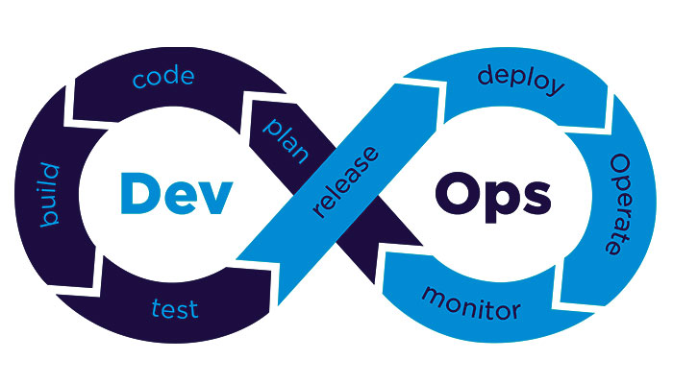
Content
Introduction to DevOps
Objectives
Description
Project Outline
Code on Web Server
Conclusion
References

Slide 3
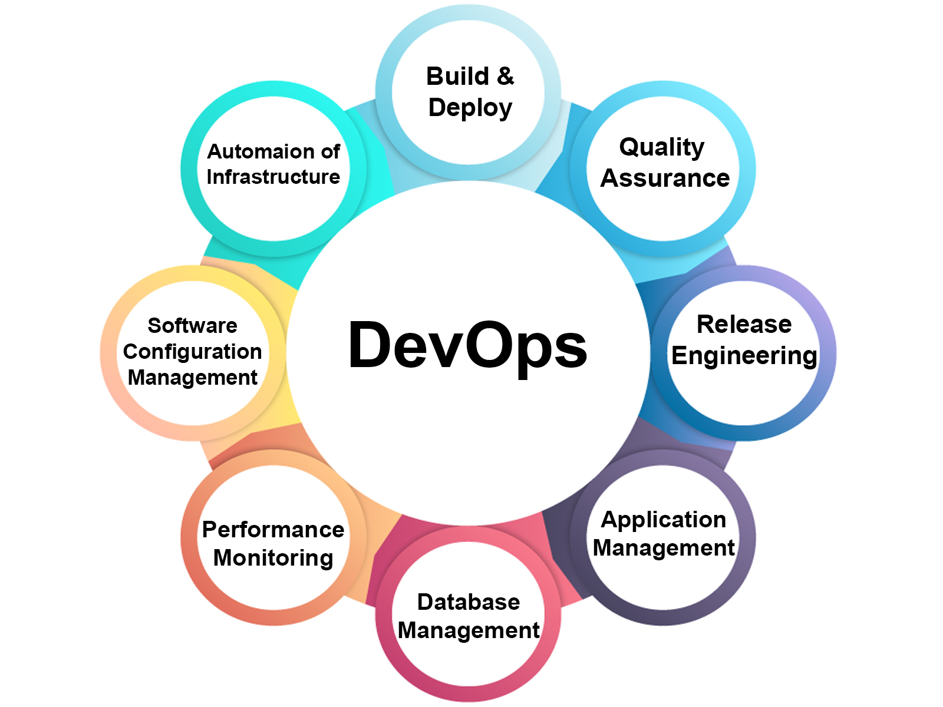
Introduction to DevOps
The term ‘DevOps’ was coined in the year 2009 by Partick Debois.
As its name implies it is a conjunction of two different words, ‘Development’ and ‘Operations’.
The reason behind this name is that it combines these two areas of an organization.

Slide 4
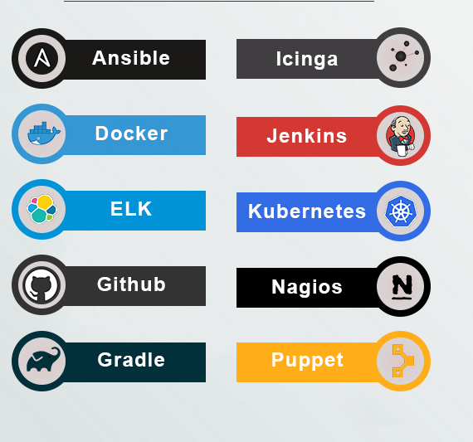
Objectives
This Setup provides Simplicity to Developers in order to build the code and make changes in cloud based webservers automatically.
Program manages multiple WebServers running in Cloud by using various DevOps tools like Kubernetes.
This also gives facility of load balancing by which we can manage load in case Users Increase or Decrease with 0% Downtime.
It automatically Scales Out the containers in case of Overloading.
Or Scales In the containers in case the load Unclutters
This whole setup will be implemented using Amazon Web Services(AWS) Cloud

Slide 5
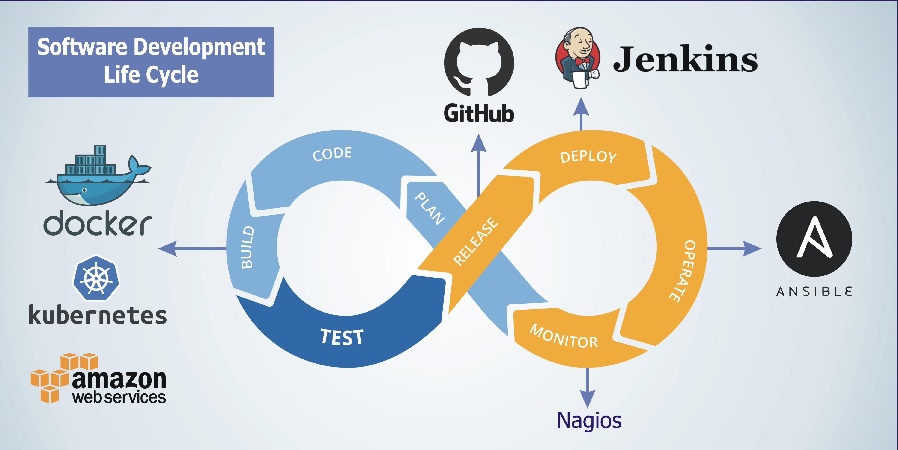
Description
Everybody thinks about minimizing users efforts, therefore we took a different approach by simplifying developers effort in managing various web servers.
We are going to develop a CI/CD Pipeline System based on DevOps which will help to minimize Developers Operations so that developers can focus on code quality rather than focusing on other problems of how to manage multiple websites, how to manage load etc.
For Developing this setup we will utilize Cloud and tools of DevOps like Docker, Kubernetes, Jenkins, Ansible and GitHub

Slide 6
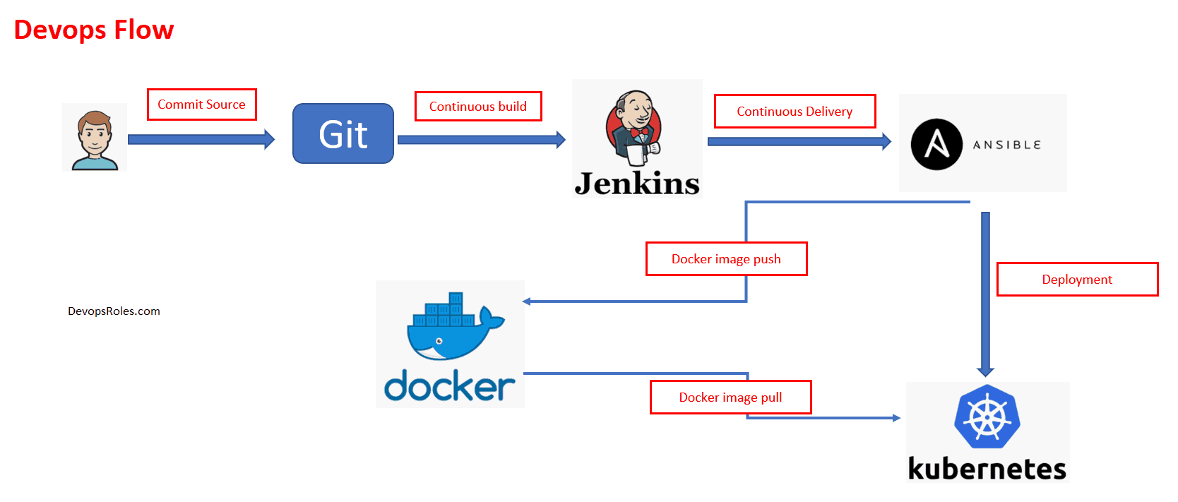
Project Outline
In this project Developers only need to focus on their code and all other tasks will be managed by this project.
After Developing the code developer just needs to push the code on GitHub.
Then comes the concept of GitHooks which will alert DevOps tools like Jenkins about the change made in GitHub.
Jenkins will pull the code from github and will make changes in Ansible and then this code will automatically get updated in all the webservers which were launched on Cloud.

Slide 7
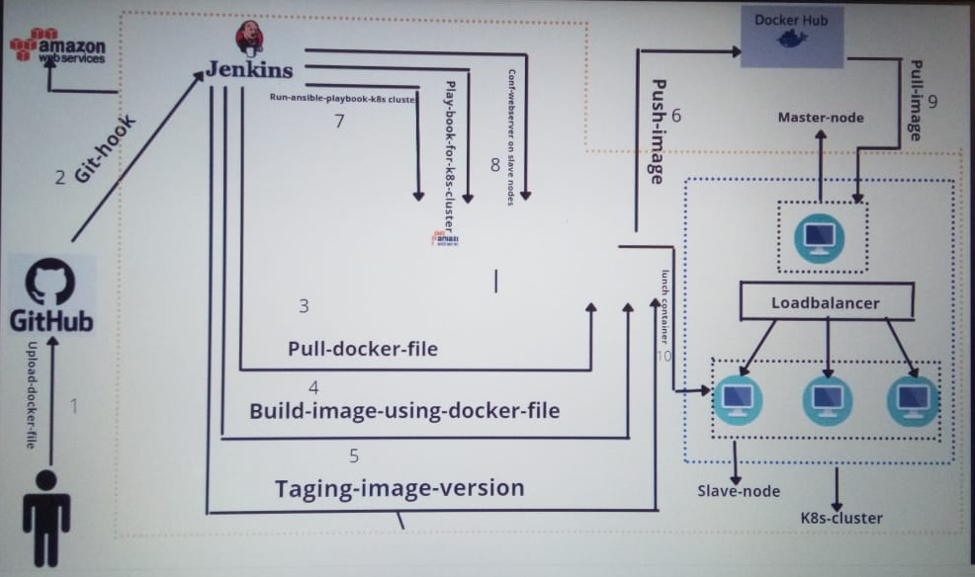

Slide 8

Code on Web server
The proposed concept is being used in our client’s website,
The website we are running on web servers is based on inventory management for client’s business.
It also provides our client accessibility to the e-commerce market through online food delivery system

Slide 9
Conclusion
There are many tools that can help enable a smoother transition to a CI/CD process. Testing is a large part of that process because even if you are able to make your integrations and delivery faster, it would mean nothing if was done so without quality in mind.
Also, the more steps of the CI/CD pipeline that can be automated, the faster quality releases can be accomplished.
This Project provides Simplicity to Developers in order to build the code and make changes in cloud based webservers automatically.
In this project we have shown how to efficiently optimize time used for relaunching instances of web server by 100% uptime.

Slide 10
References
https://www.digitalocean.com/community/tutorials/how-to-install-jenkins-on-ubuntu-18-04
https://www.shellhacks.com/install-jenkins-ubuntu-centos/
https://docs.ansible.com/ansible/latest/user_guide/intro_dynamic_inventory.html

Slide 11
Thank You !

